Slide 1


PLEDGE RED
presented by:
E.Neerupam 21EG112A11
G.Chandu 21EG112A12
K.Vaishnavi 21EG112A19
V.Santhosh 21EG112A56
K.Siri Chandana 22EG512A06

Slide 2
CONTENTS:
Project Title | Blood Management System
Abstract | Pledge Red is an application that stores, processes, retrieves, and analyzes data about blood bank administration
Language/Technologies used | JAVA
IDE | Visual Studio Code
Database | SQL
Java version(recommended) | JDK 19.0

Slide 3
Abstract
Pledge Red is an application that stores, processes, retrieves, and analyzes data about blood bank administration.
It also supervises blood inventory management and other blood bank-related activities.
It is a standalone application.
It provide user friendly service person who need was in need of blood.
It fills the gap between the donar and the person who is in need of blood .
While taking the blood from the donar it takes information about there
age ,weight .gender and blood group of donar.
It also take pincode of donar while he is donating blood so that we can facilitate with no time when the person is in need of blood

Slide 4
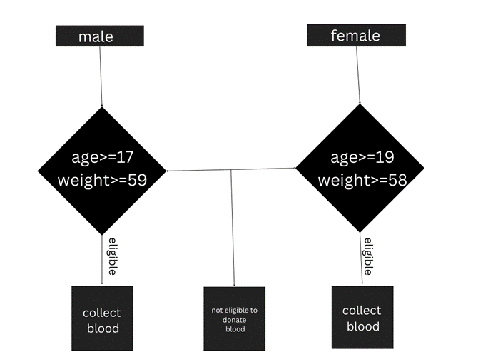

Flow of control
class blood
{
String name,pincode,rt,phone,blood;
char gender;
int weight,age;
}

Slide 5
System requirements
Hardware requirements:
2GB ram memory.
Intel core i3 processor.
Software requirements:
Window 7 or above operating system.
Sql server.
Technolongies used:
Java language includes JDBC
SQL database is used.

Slide 6
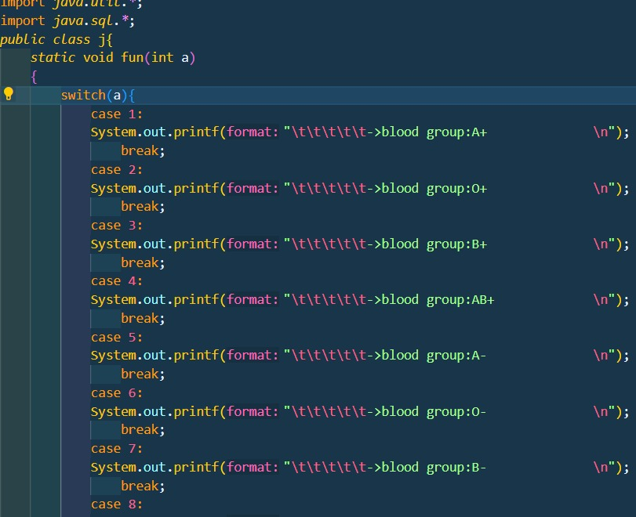
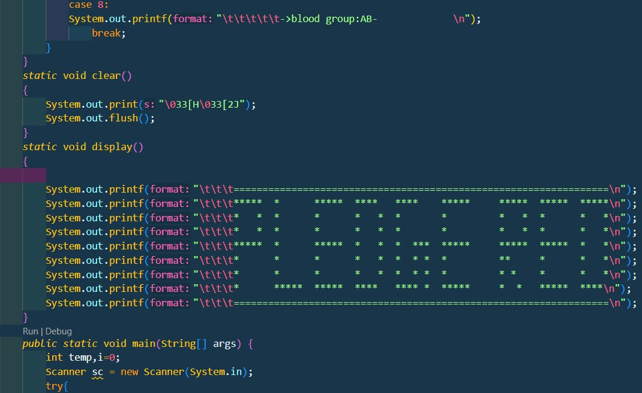
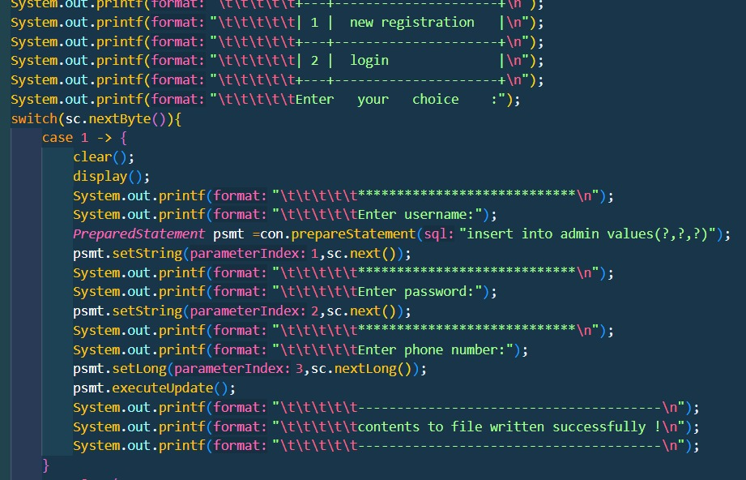
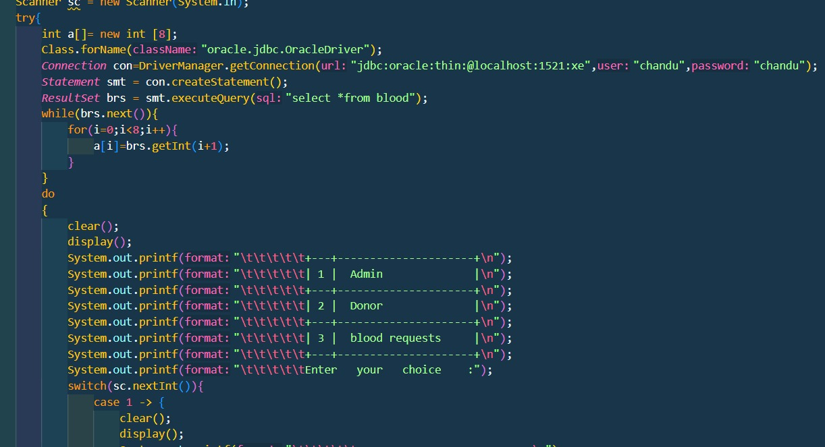
CODE

Slide 7
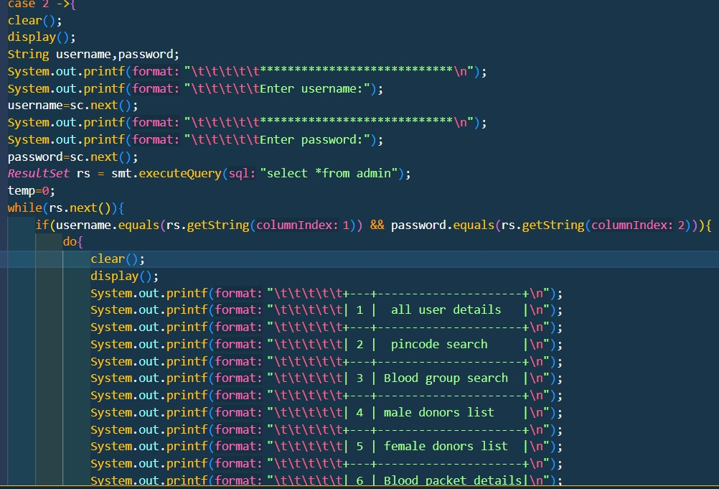
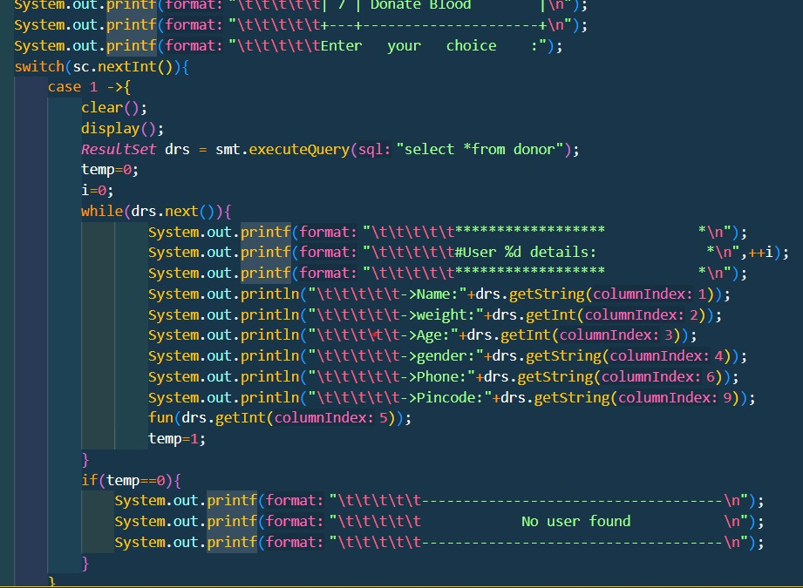
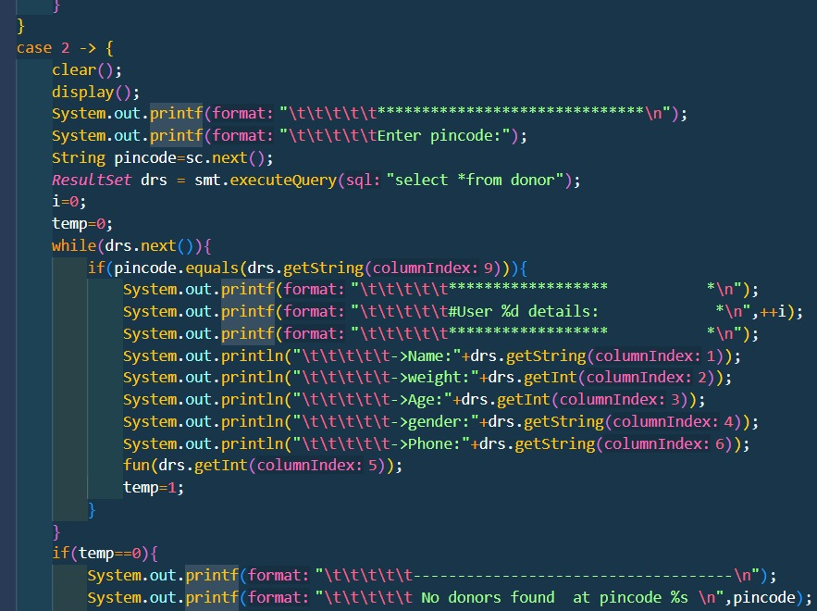
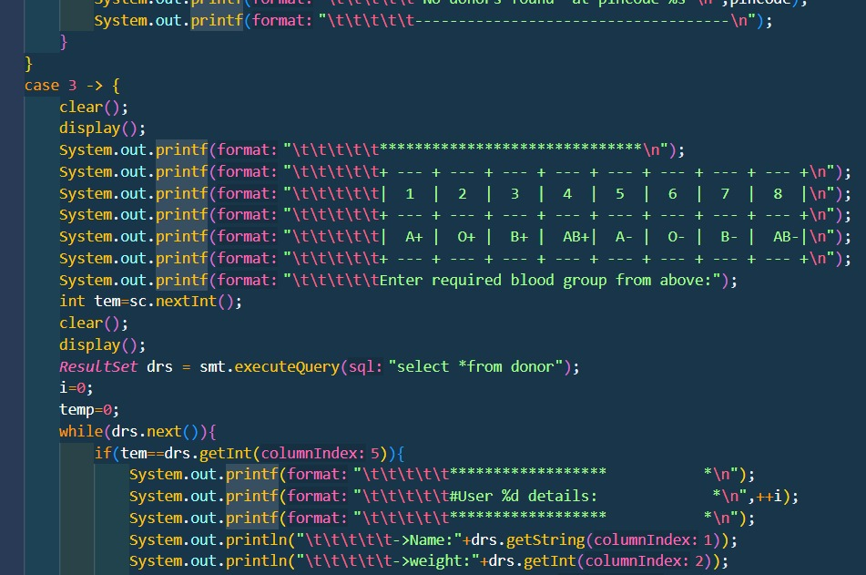
CODE

Slide 8
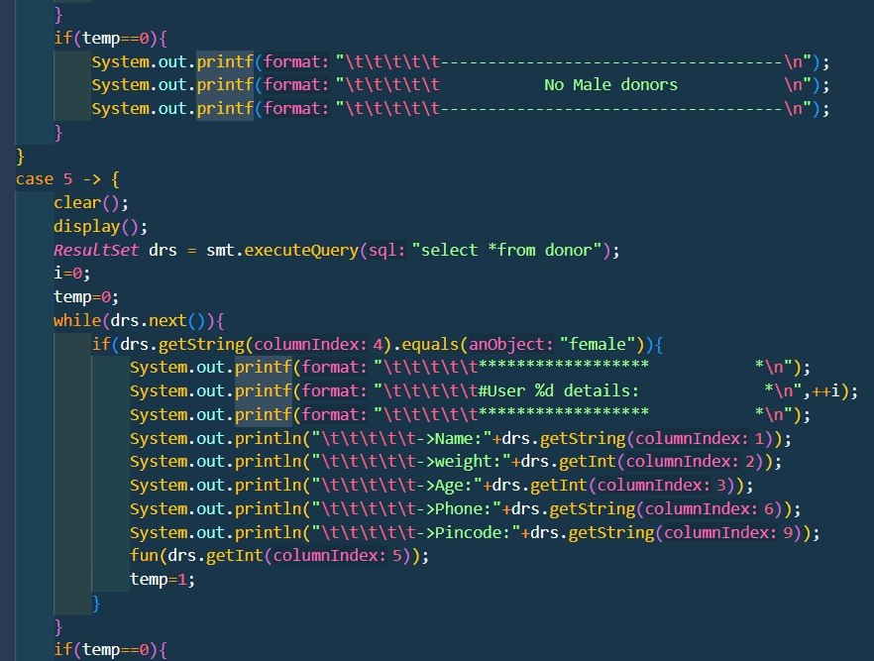
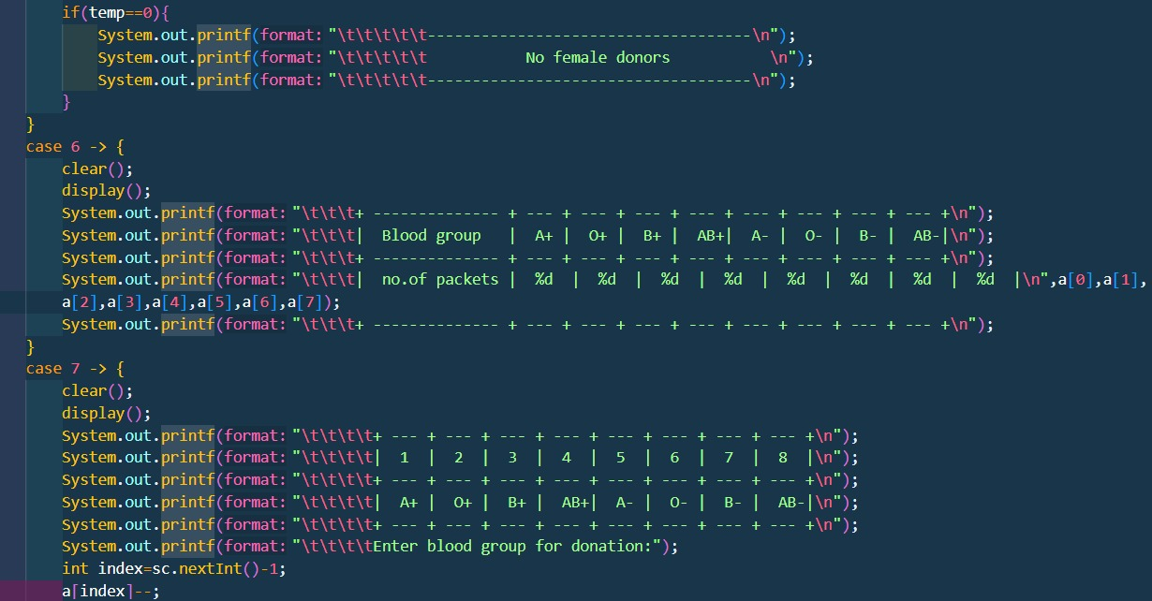
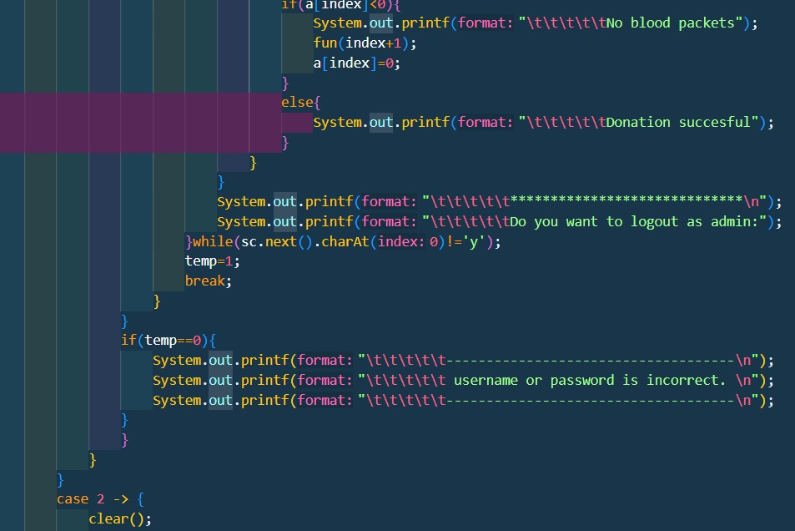
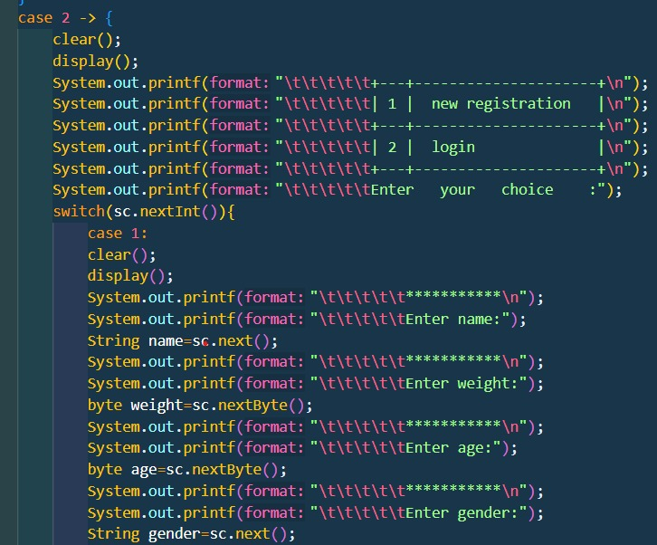
CODE

Slide 9
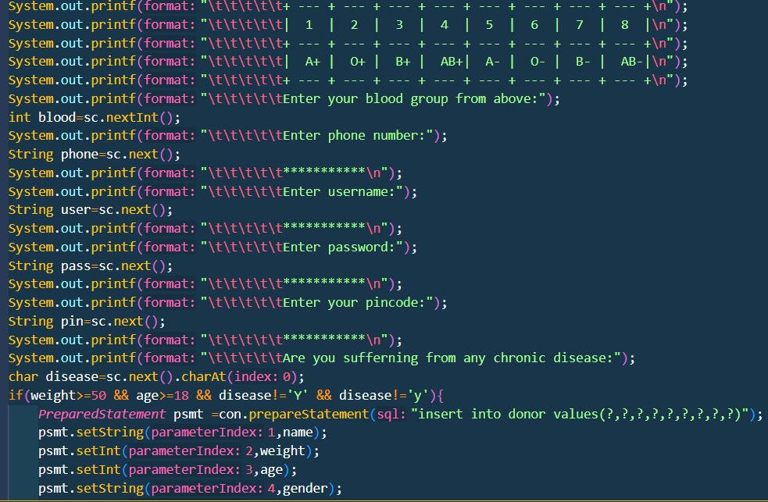
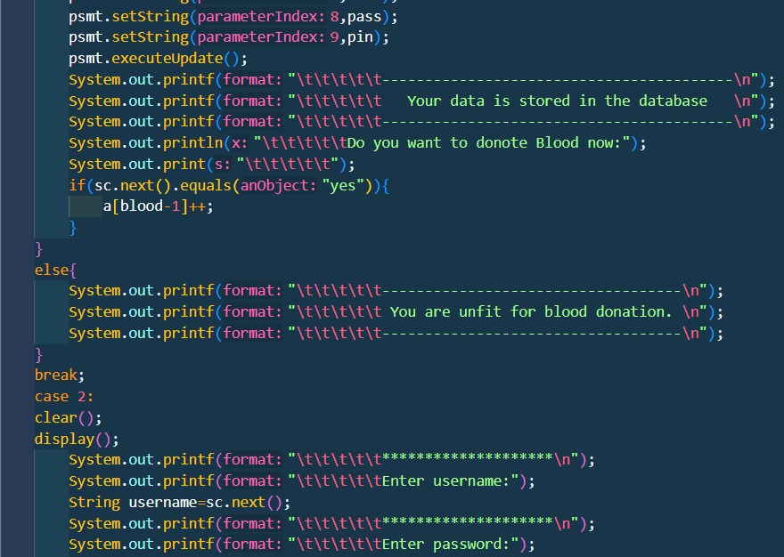
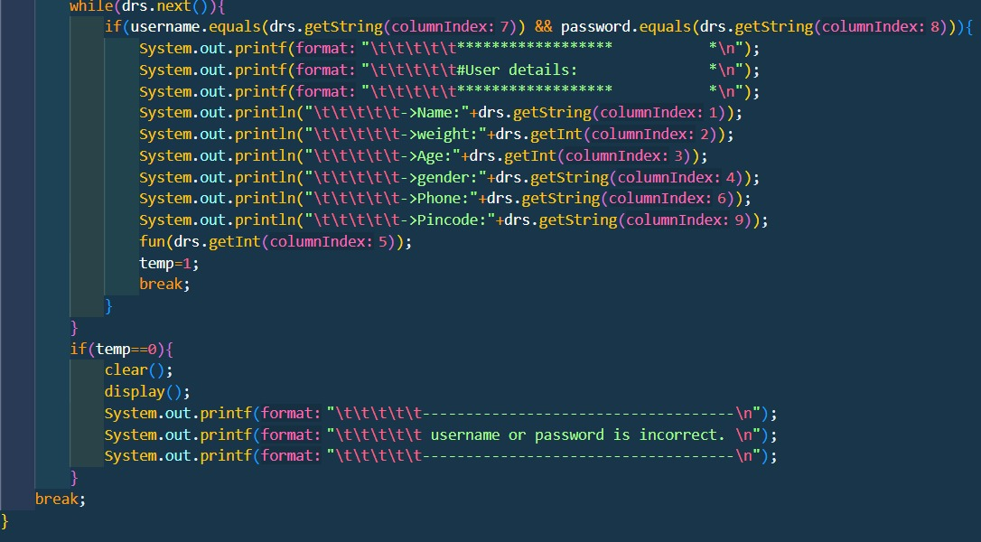
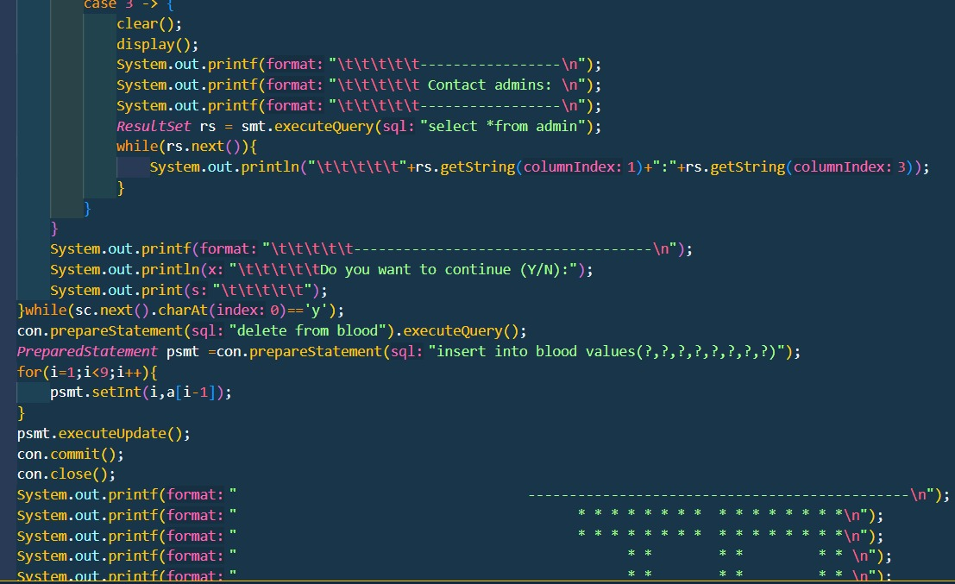
CODE

Slide 10
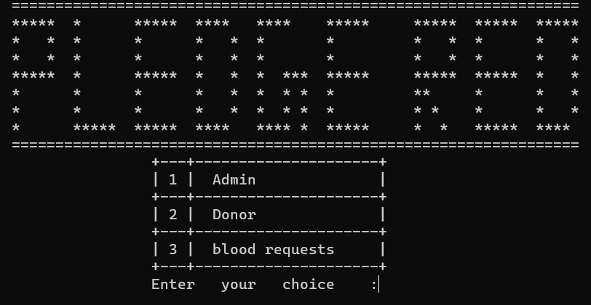
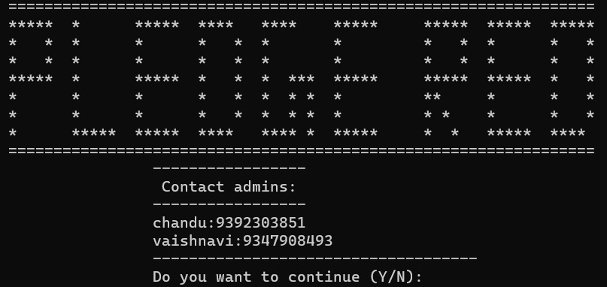
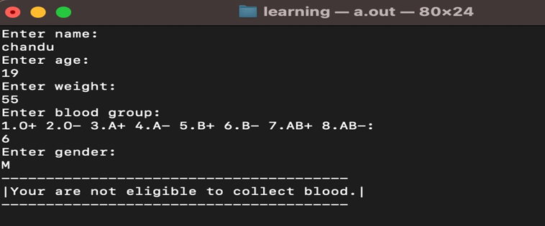
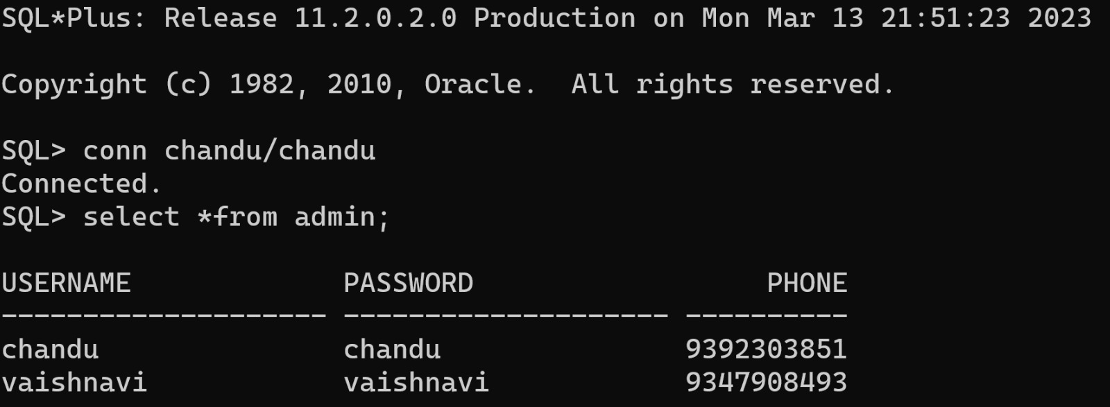
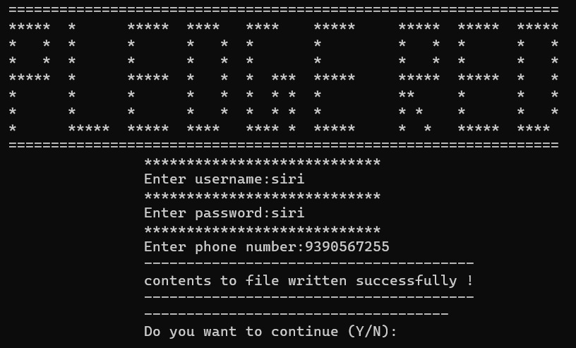
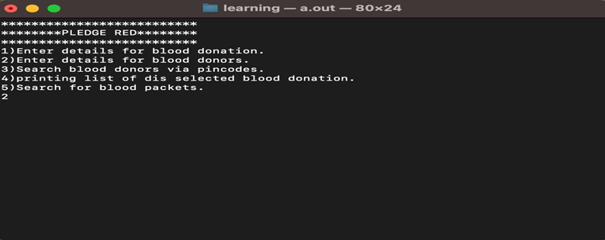
Out put

Slide 11
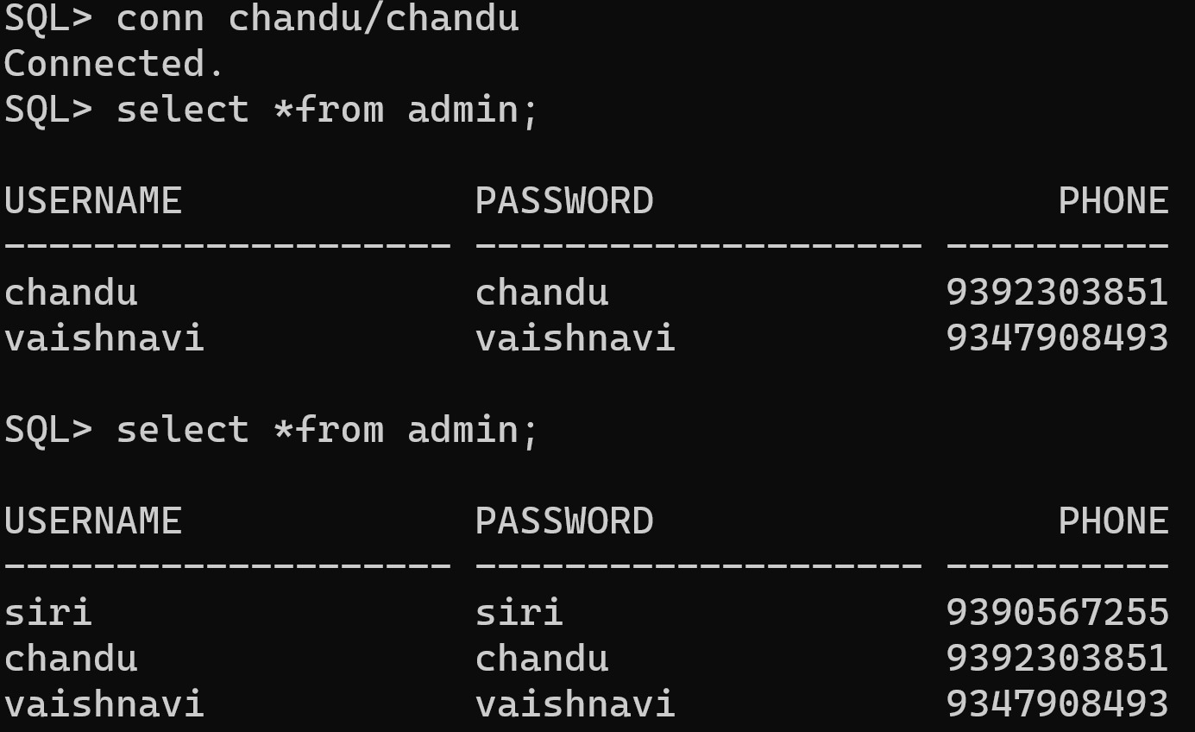
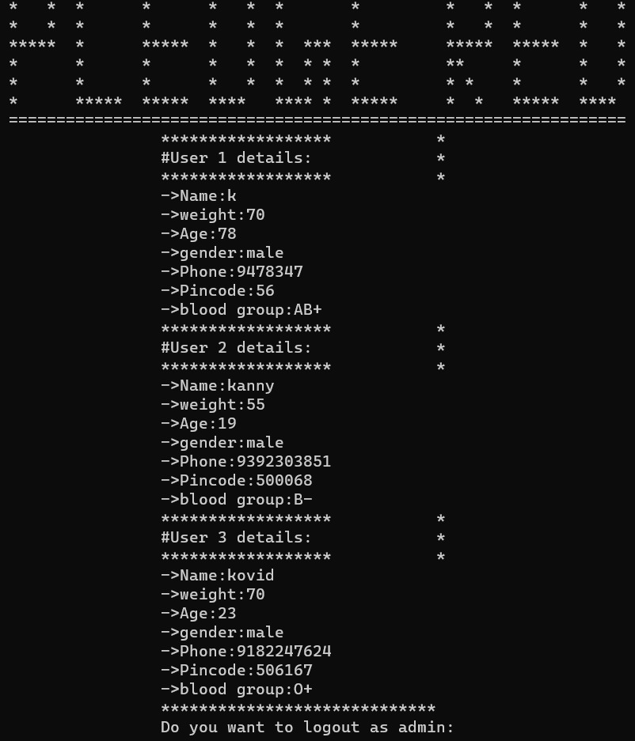
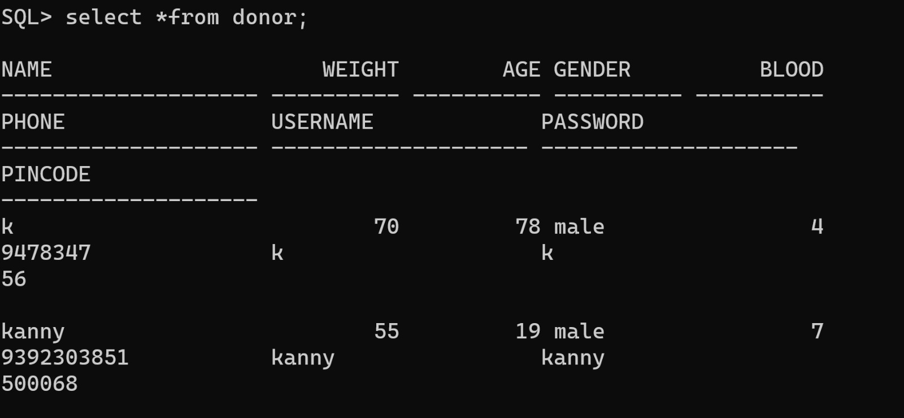
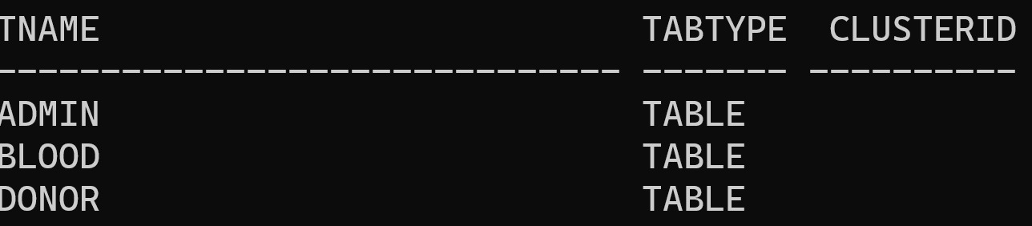
Out put

Slide 12

THANK YOU

